Slide 1



OSI Model

Slide 2
What is OSI Model?
OSI – Open System Interconnection model
The OSI model is a conceptual model of how the Internet works. The main goals of the OSI model are to help people talk about networking equipment and protocols, determine which protocols are used by which software and hardware, and show how the Internet can function regardless of the underlying hardware.
The OSI model divides the different technologies that make the Internet work into layers.
There are 7 layers in OSI Model

Slide 3
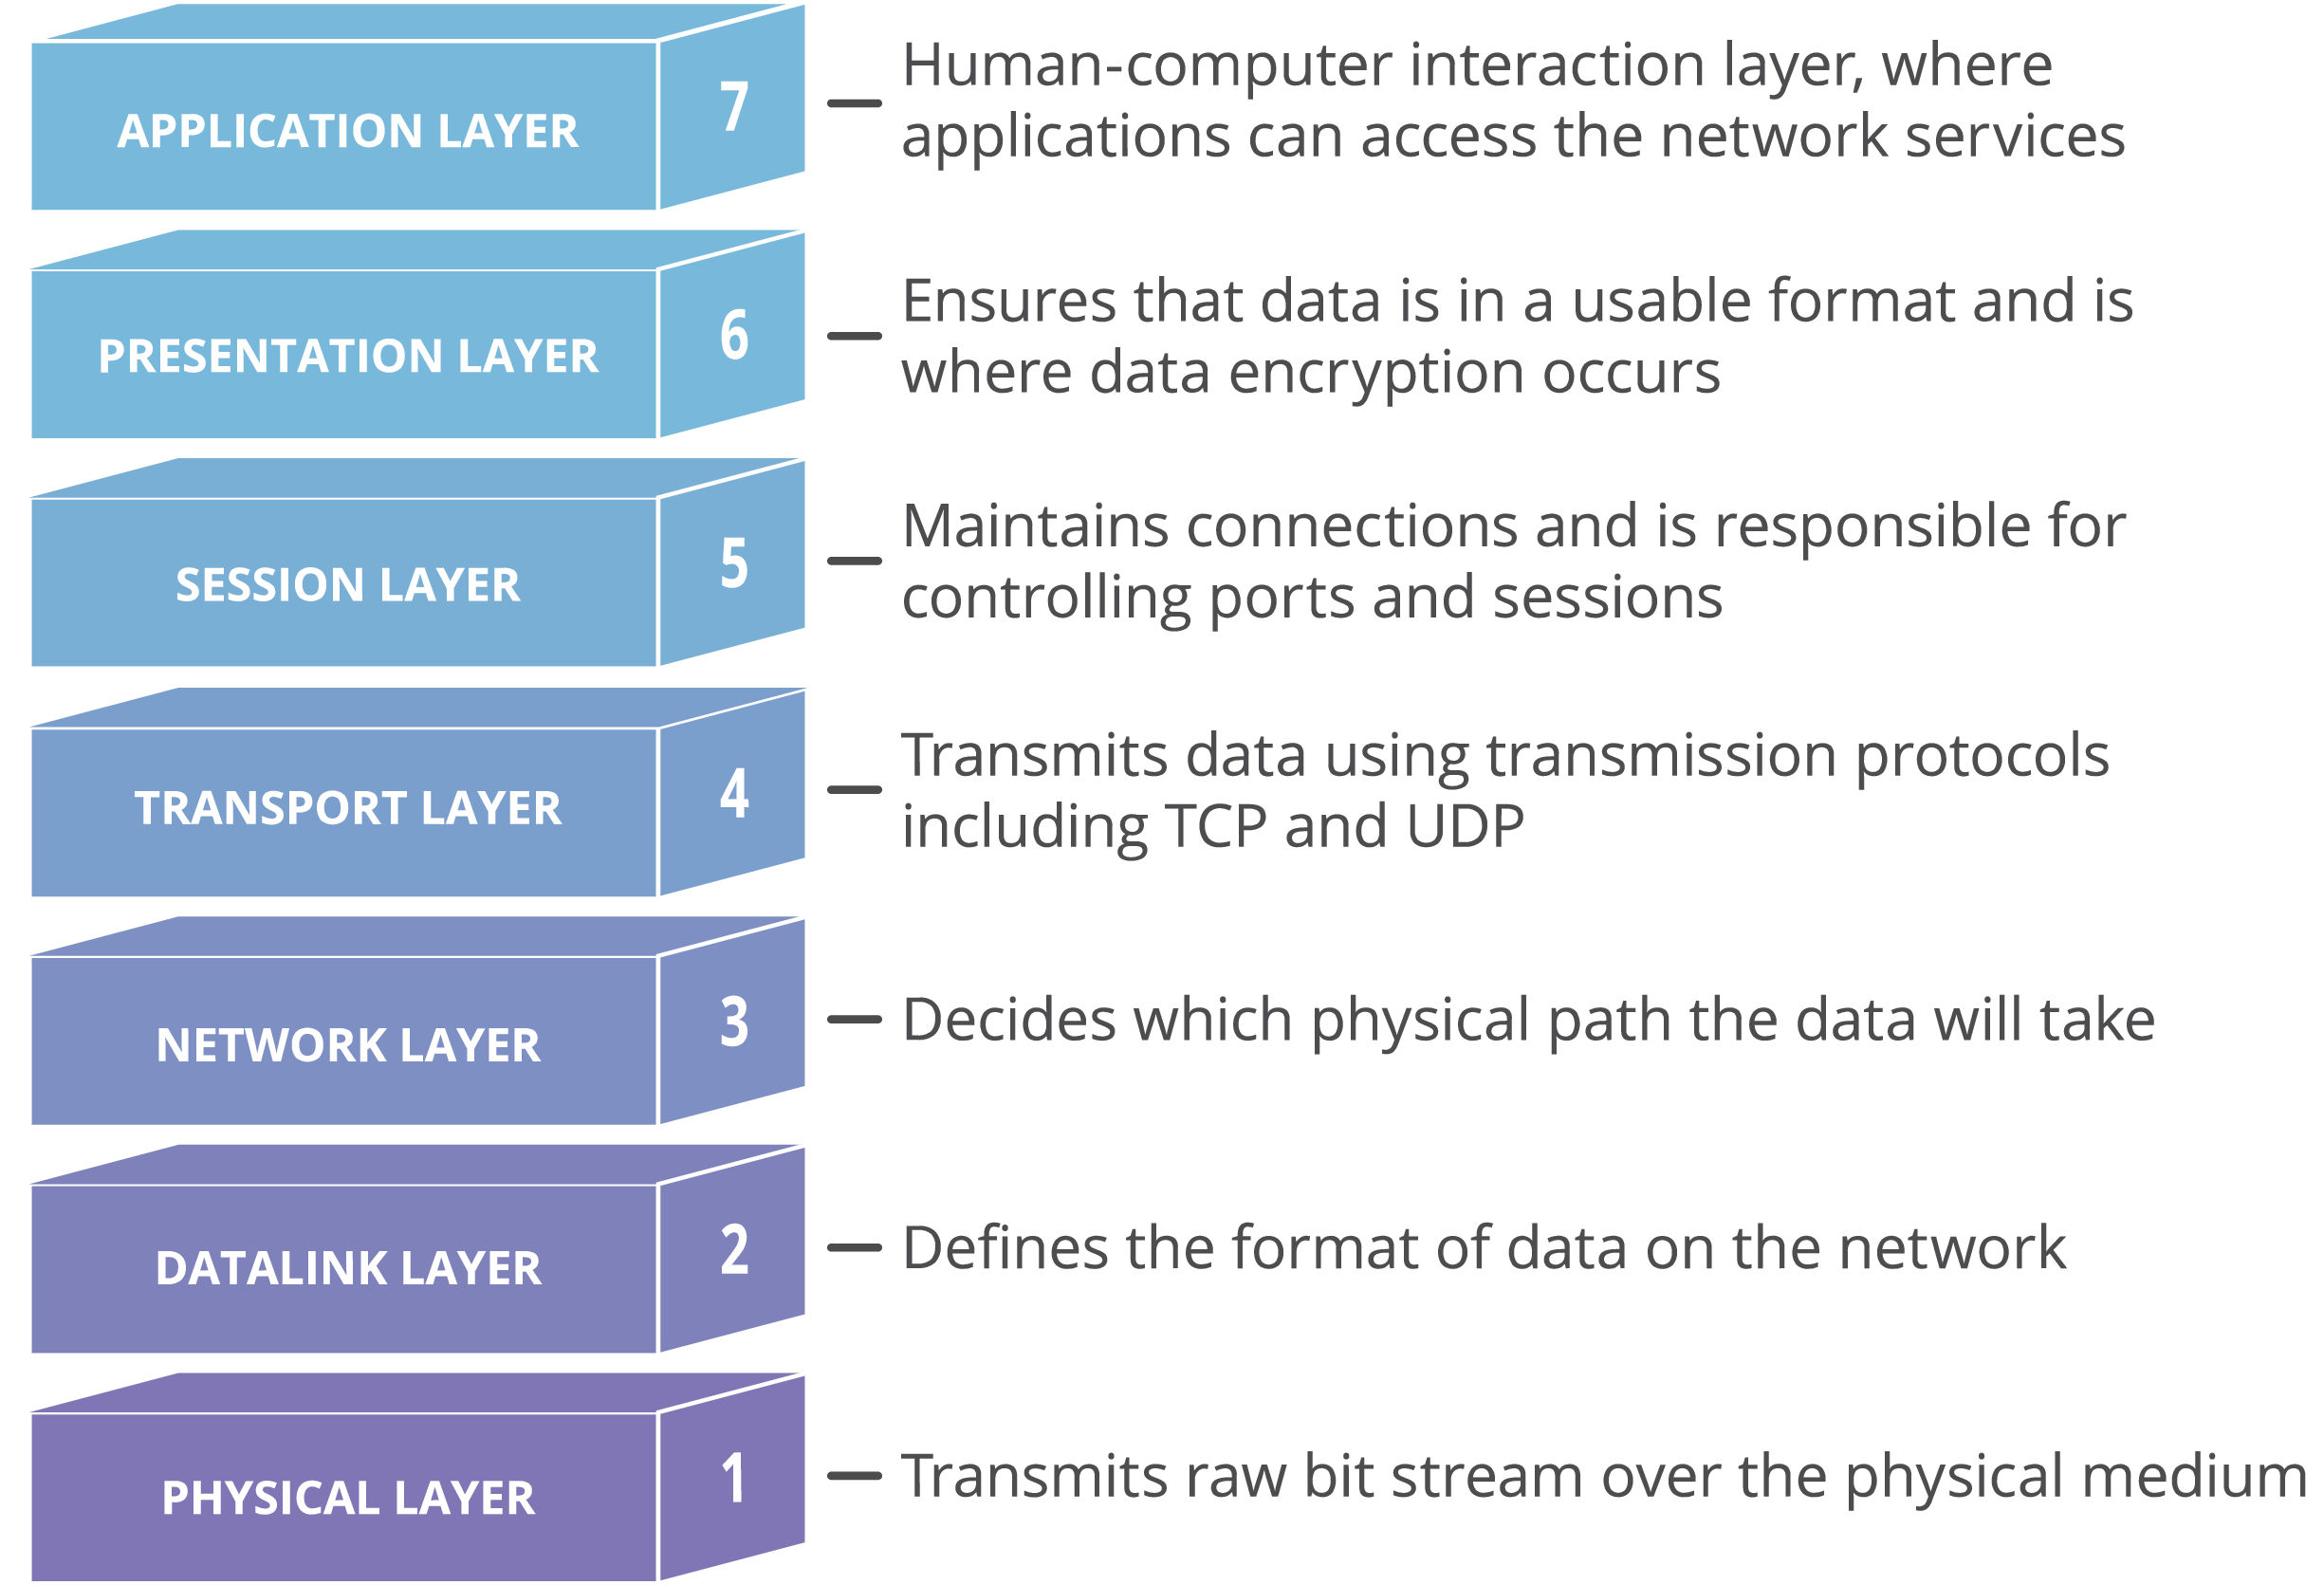

Slide 4
7.Application Layer This is the only layer that directly interacts with data from the user. Software applications like web browsers and email clients rely on the application layer to initiate communications.

Slide 5
6.Presentation Layer This layer is primarily responsible for preparing data so that it can be used by the application layer; in other words, layer 6 makes the data presentable for applications to consume. The presentation layer is responsible for translation, encryption, and compression of data.

Slide 6
5.Session Layer This is the layer responsible for opening and closing communication between the two devices. The time between when the communication is opened and closed is known as the session. The session layer ensures that the session stays open long enough to transfer all the data being exchanged, and then promptly closes the session in order to avoid wasting resources.

Slide 7
4. The Transport Layer
Layer 4 is responsible for end-to-end communication between the two devices. This includes taking data from the session layer and breaking it up into chunks called segments before sending it to layer 3. The transport layer on the receiving device is responsible for reassembling the segments into data the session layer can consume.

Slide 8
3. The network layer
The network layer is responsible for facilitating data transfer between two different networks. If the two devices communicating are on the same network, then the network layer is unnecessary. The network layer breaks up segments from the transport layer into smaller units, called packets, on the sender’s device, and reassembling these packets on the receiving device. The network layer also finds the best physical path for the data to reach its destination; this is known as routing.

Slide 9
2. The data link layer
The data link layer is very similar to the network layer, except the data link layer facilitates data transfer between two devices on the same network. The data link layer takes packets from the network layer and breaks them into smaller pieces called frames.

Slide 10
1. The physical layer
This layer includes the physical equipment involved in the data transfer, such as the cables and switches. This is also the layer where the data gets converted into a bit stream, which is a string of 1s and 0s. The physical layer of both devices must also agree on a signal convention so that the 1s can be distinguished from the 0s on both devices.

